Slide 1
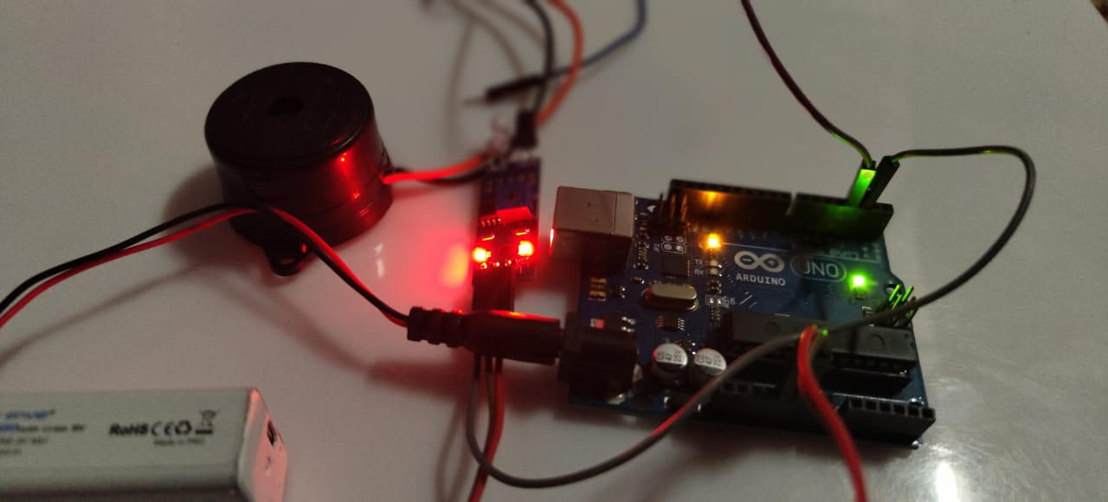
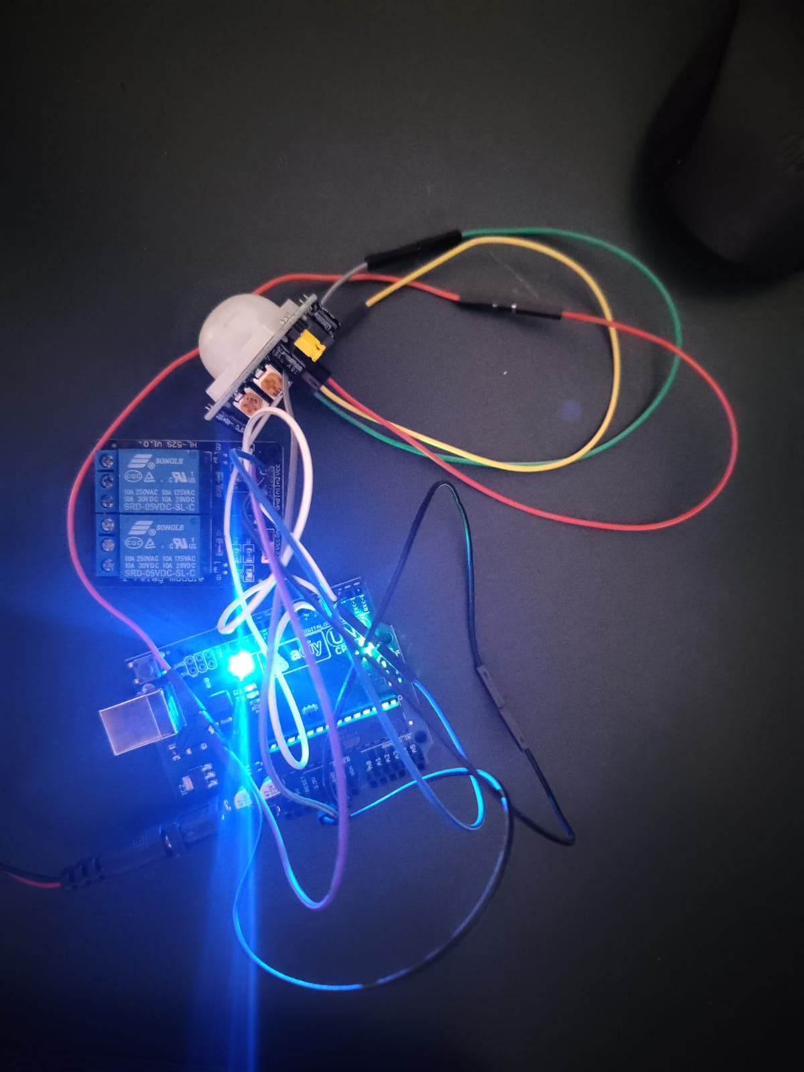
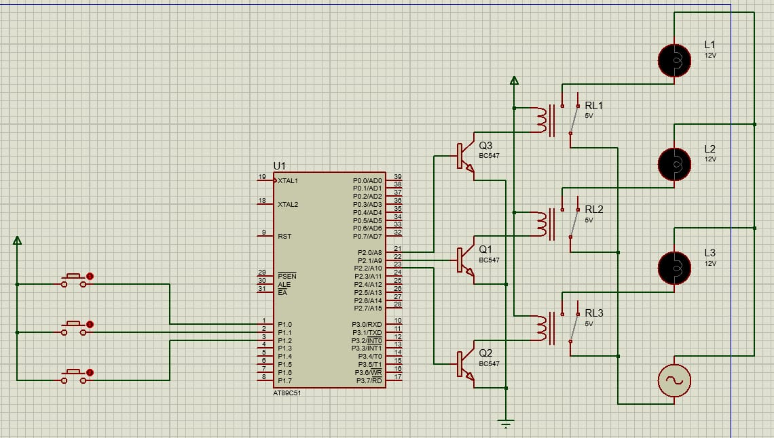
IOT BASED SMART LIGHT AND VEHICLE CROSSING ALERT WITH INDICATION SYSTEM IN HILL STATION
SAKTHI DHASAN.K(130720205305)
DHILIP KUMAR.D(130720205303)
GUIDE: Mrs. CHRISTY GRACE, Assistant Professor-IT
ABSTRACT
RESULT
The project is used to avoid the accident in hill station
It uses the alert and indication system for vechile crossing
The zigzag component of the picture above minimizes the grade, or steepness of the roadway.
If you have ever ridden a bike up a steep hill, you might have found yourself zigzagging back and forth across the roadway to get up the hill.
The same principle applies here. When designing a roadway, there are guidelines as to the length of the radius of curve based primarily on the design speed.
The project is IoT Based Smart lights And Vechile Crossing Alert with Indication Systems In Hill Station With the help of an PIR Sensor, we will control the smart light and vehicle alert system.
When if any vehicle is crossing the sensor above the lights blow automatically because of the sensor triggered.
This project presents an advance lighting system to minimize the wastage of electrical power and save electricity. For this purpose we are using Arduino, Light Dependent Resistor(LDR) and Passive Infrared (PIR) motion sensor. Light will be switched on when LDR detects moment.
.
OBJECTIVE
Drivers face the risk of accidents when driving on hairpin bends due to lack of communication and zero visibility over the hairpin curves.
Averting collisions between vehicles mainly occurring in hairpin bends, short corners, blind curves, etc. using Arduino microcontroller.
Alerting the driver about the vehicles coming from the opposite side in Ghats sections by keeping an ultrasonic sensor on one side of the road before the curve and keeping a LED light after the curve.
ARCHITECTURE DIAGRAM
CONCLUSON AND FUTURE WORK
This project presents an advance lighting system to minimize the wastage of electrical power and save electricity.
For this purpose we are using Arduino, Light Dependent Resistor(LDR) and Passive Infrared (PIR) motion sensor.
Light will be switched on when LDR detects moment. We are using LDR to reduce unnecessary wastage of power during daytime and increase the efficiency of system.
This project can also work as a security system. This project can also be used in smart light system..
REFERENCES
[1]. L. Goswami, M. K. Kaushik, R. Sikka, V. Anand, K. Prasad Sharma and M. Singh Solanki, "IOT Based vehicle Detection of hill station through Node MCU Module," 2020 International Conference on Computer Science, Engineering and Applications (ICCSEA), Gunupur, India, 2020, pp. 1-6, doi: 10.1109/ICCSEA49143.2020.9132893.
[2]. Goswami and P. Agrawal, "IOT based smart lights in Power Line Transmission through GOOGLE Firebase database," 2020 4th International Conference on Trends in Electronics and Informatics (ICOEI)(48184), Tirunelveli, India, 2020, pp. 415-420, doi: 10.1109/ICOEI48184.2020.9143007.
[3]. Baoan Lia, Jianjun Yub “Research and application on the smart home based on Component technologies and Internet of Things”.
.

